Slide 1
Dealing with Problem Complexity, Uncertainty, Risk, and Ambiguity
By
Dr. Bijaya Bijeta Nayak

Slide 2
Introduction
Engineering professionals frequently face challenges that are not straightforward. In the real world, problems are rarely well-defined; instead, they involve multiple variables, conflicting objectives, incomplete data, and external constraint
Engineering problems are often complex, uncertain, risky, and ambiguous.
Engineers must learn to manage these aspects for effective decision-making.
Dealing with problem complexity, uncertainty, risk, and ambiguity is a fundamental skill for modern engineers. Future-ready engineers must be equipped not only with technical knowledge but also with systems thinking, decision-making under uncertainty, and effective risk management capabilities.

Slide 3
Why CURA Matters
Understanding Complexity, Uncertainty, Risk, and Ambiguity (CURA) is crucial because it equips engineers with a structured way of thinking:
Complexity → Helps recognize system interdependencies.
Uncertainty → Prepares for unknowns and variability.
Risk → Focuses attention on consequences and probabilities.
Ambiguity → Encourages clear communication and problem framing.

Slide 4
Problem Complexity
Complexity arises when a problem has many interconnected parts, variables, or subsystems, where changes in one element affect others unpredictably.

Slide 5
Characteristics of Complex Problems
Multiple interdependent variables
Non-linear cause-and-effect relationships
Requires multidisciplinary knowledge
May lack a single “right” solution

Slide 6
Approaches to Handle Complexity:
Systems Thinking: Understanding interconnections between subsystems.
Modeling and Simulation: Using mathematical/AI models to represent systems.
Decomposition: Breaking complex problems into smaller, manageable parts.
Collaboration: Engaging experts from different domains.

Slide 7
Uncertainty
Uncertainty refers to incomplete knowledge about a system, process, or future outcome.
Types of Uncertainty:
Aleatory (Randomness): Due to inherent variability (e.g., material properties, weather).
Epistemic (Knowledge-based): Due to lack of data, measurement errors, or limited models.

Slide 8
Examples in Engineering:
Predicting fatigue life of a component under variable loading.
Forecasting renewable energy generation (solar/wind).
Strategies to Manage Uncertainty:
Collect more data (experiments, testing).
Use probabilistic methods (Monte Carlo simulation).
Apply sensitivity analysis to identify critical factors.
Adopt robust design principles.

Slide 9
Risk
Risk is the possibility of an adverse outcome due to uncertainty
Risk = Probability × Consequence.
Examples in Engineering:
Risk of failure in a bridge due to material fatigue.
Cybersecurity risk in industrial IoT systems.
Financial risk in adopting new technologies.

Slide 10
Risk Management Process:
Risk Identification – What can go wrong?
Risk Assessment – Likelihood & severity.
Risk Mitigation – Preventive and corrective measures.
Risk Monitoring – Continuous tracking and updates.

Slide 11
Ambiguity
Ambiguity arises when information is open to multiple interpretations or when goals and priorities are unclear.
Sources of Ambiguity:
Poorly defined problem statements.
Conflicting stakeholder requirements.
Lack of common terminology or standards.

Slide 12
Examples in Engineering:
Ambiguous customer requirements in product design.
Policy uncertainty in renewable energy projects.
Strategies to Reduce Ambiguity:
Improve communication and documentation.
Engage stakeholders early and frequently.
Use prototyping and iterative design.
Develop decision-support tools.

Slide 13
Interrelation of Factors
Complexity increases uncertainty.
Uncertainty creates risk.
Ambiguity makes assessment and communication difficult.
Engineers must balance all four challenges.

Slide 14
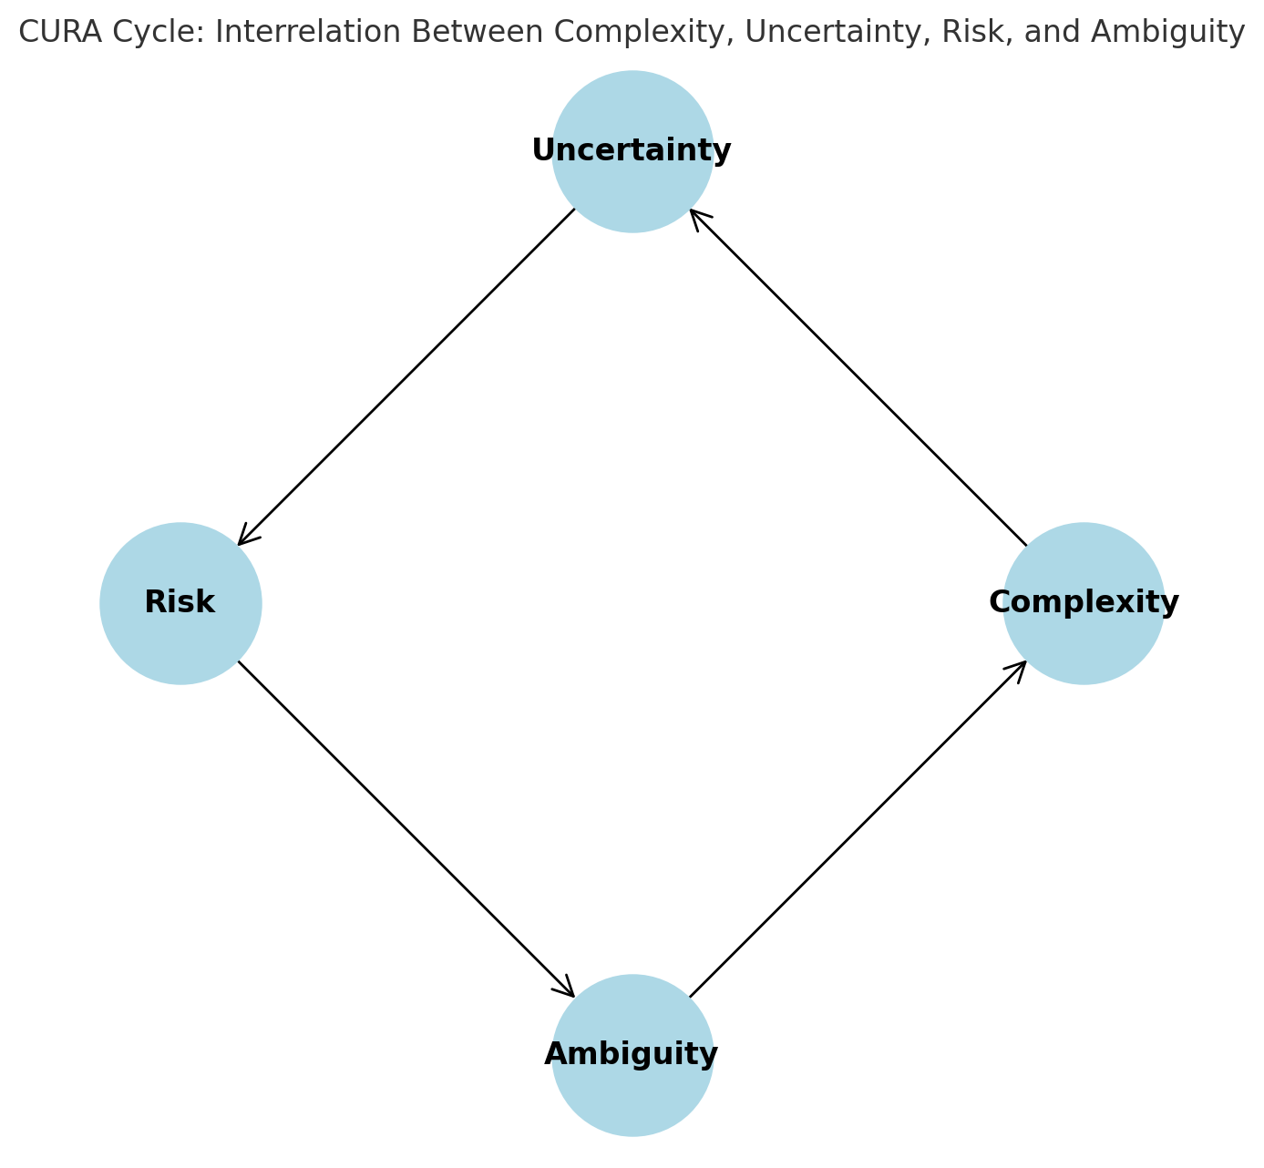

Slide 15
Examples/ Case Studies in Engineering:
Designing smart manufacturing systems (Industry 4.0)
Urban transportation planning
Sustainable energy systems integration

Slide 16
Designing smart manufacturing systems (Industry 4.0)
Smart manufacturing (also called Industry 4.0) integrates automation, IoT, AI, robotics, and data analytics to optimize production systems.
Why Complex?
Multiple interconnected technologies (sensors, robotics, cloud systems, AI algorithms).
Data flows across different machines, networks, and decision layers.
Cyber-physical systems need integration across hardware and software.
Uncertainty Factors:
How new technologies will perform at large scale.
Data quality and reliability from IoT sensors.
Rapid technology evolution — tools chosen today may be outdated tomorrow.
Risks:
Cybersecurity attacks on automated systems.
System downtime due to integration failures.
High financial risk from investing in expensive but unproven technologies.
Ambiguity:
Lack of clear industry standards for interoperability.
Different stakeholders (management, operators, IT teams) may interpret “smart manufacturing” differently.

Slide 17
Urban transportation planning
Designing metro systems, bus rapid transit, or smart traffic control involves engineering, policy and social dimensions.
Why Complex?
Involves roads, rail, traffic signals, pedestrian pathways, vehicles, and human behavior.
Multiple stakeholders: government, citizens, transport operators, environmental groups.
Huge infrastructure scale — interconnected subsystems (stations, power, signaling, vehicles).
Uncertainty Factors:
Unpredictable population growth and travel demand.
Uncertainty in fuel prices or future mobility trends (e.g., electric vehicles, shared mobility).
Data gaps in traffic surveys and travel behavior.
Risks:
Cost overruns and delays in mega projects.
Safety risks (accidents, infrastructure failure).
Political risk if the system fails to meet public expectations.
Ambiguity:
Conflicting goals: some prioritize low-cost solutions, others environmental sustainability.
Policy directions (e.g., should funds go to metro rail or road expansion?) may be unclear.

